Slide 1
Research Update 2023 Q1 Bo, 03 March 2023

Slide 2
Data Processing using SLINGtools (MiDAR)
https://github.com/SLINGhub/SLINGtools
AIM: Efficient, reproducible and consistent data processing/QC
1) You need:
- Data files (MH Quant, MRMkit, plain csv,…)
- Metadata (Jemery’s, XLXS, LIMS)
2) You will get:
- Processed dataset
- QC: plots and numbers
- LIMS matching
- Report in EXCEL
- Report in PPTX / DOCX / PDF

Slide 3
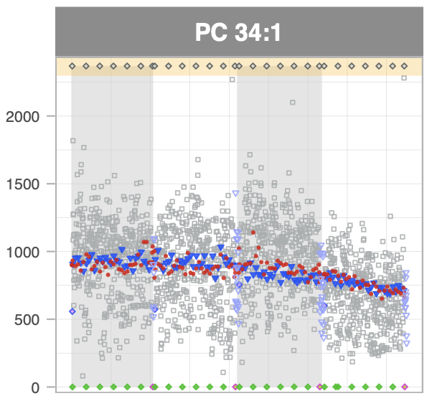
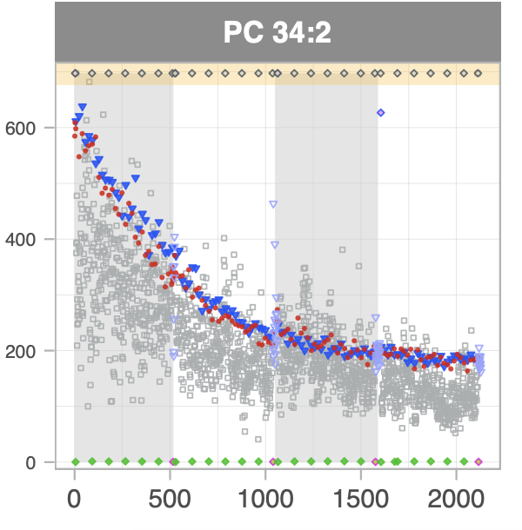
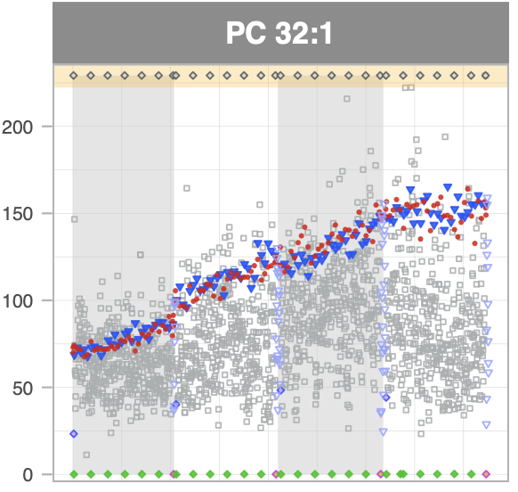
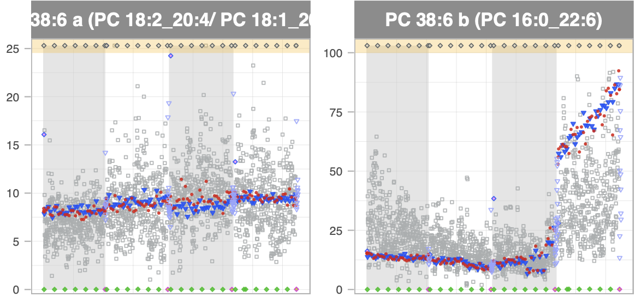
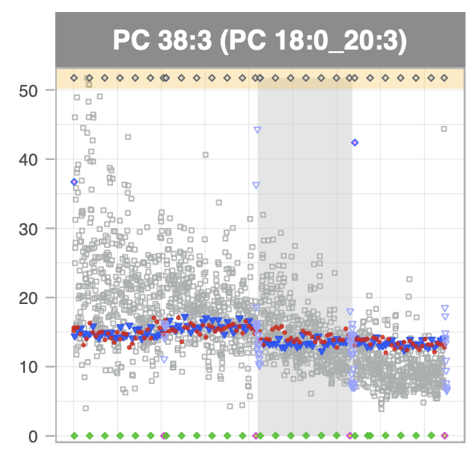
Effects
μmol/L
Run order

Slide 4
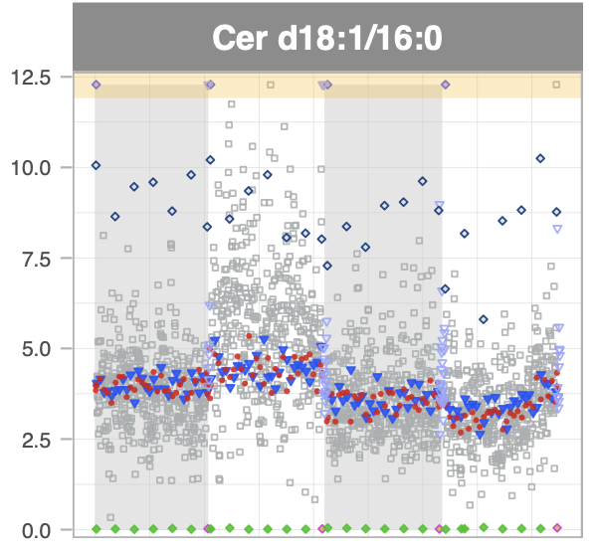
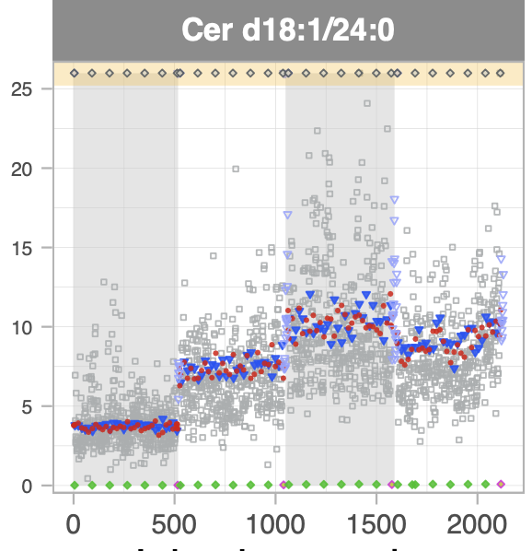
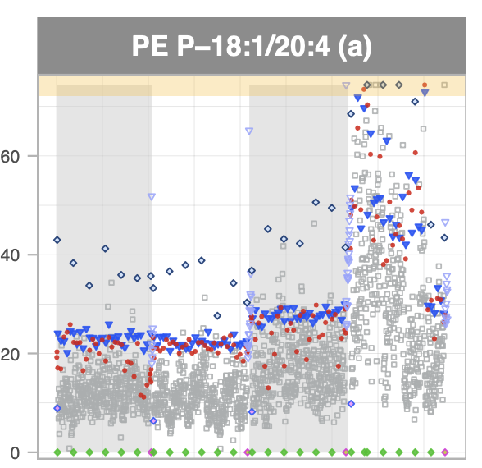
Effects
μmol/L
Run order

Slide 5
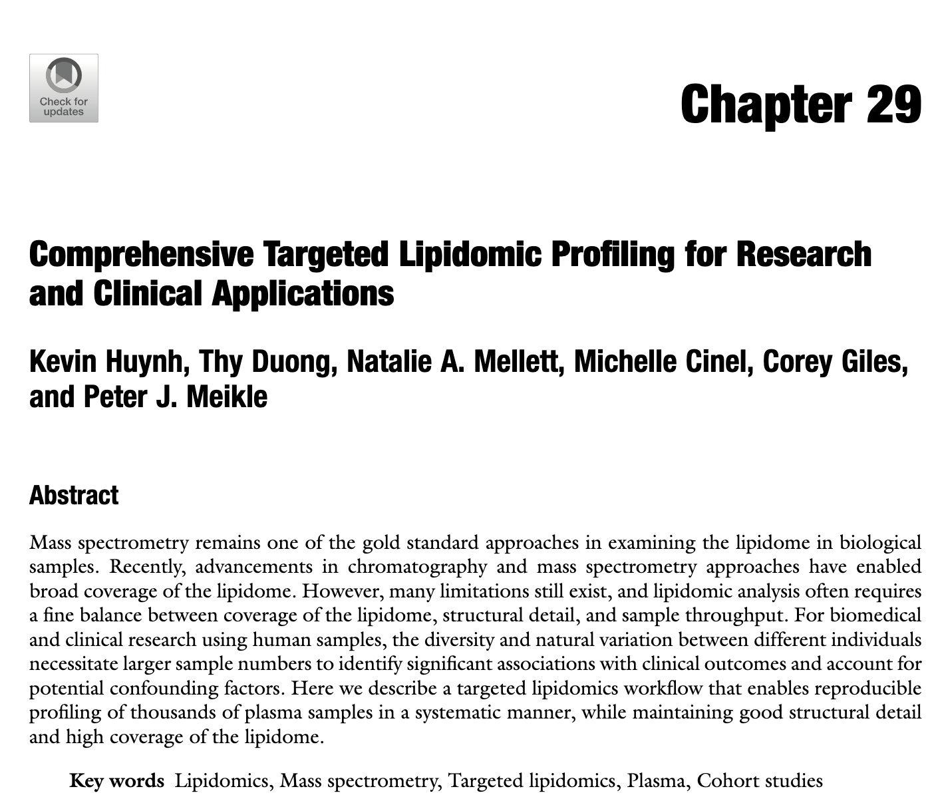
What do we learn and do !?
Aim to do a SST BEFORE the run (how can we help?)
Check your run DURING the run (dare to stop it…)
Check your run AFTER the run (dare to re-run it…)
Are our instrument methods OK?
Share issues !!
Learn from data
“Must read”

Slide 6
Healthy Athletes
Lipidomics Analysis Report V1.1 SLING / 03 March 2023

Slide 7
QUALITY CONTROL

Slide 8
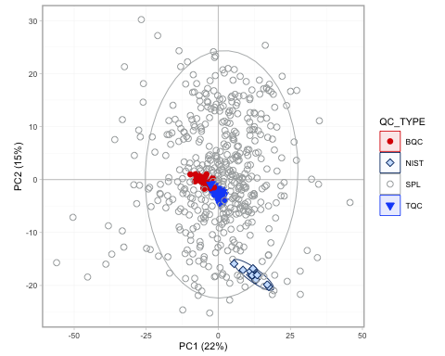
QC and Sample Variability and Outliers
Figure 1: PCA of all QCs and samples BQCs (Batch QCs) are pooled samples co-extracted with samples that represent the sample preparation and MS analysis variability. The TQC (technical QCs) is a common sample measured at regular intervals to monitor the instrument stability. Ideally, the BQC should be centered closely in the middle. No appearednt outliers. PASSED.

Slide 9
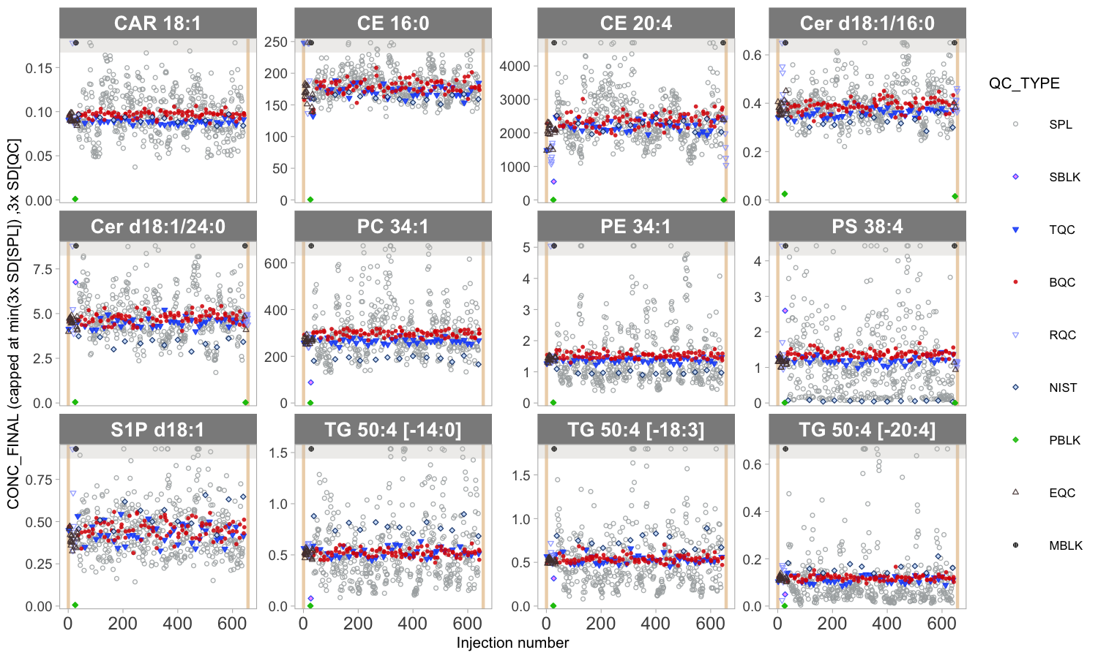
Analytical Robustness
Figure 2: Concentrations of selected species in QC and study sample arranged by analysis order. No appearent batch effects and drifts, QC samples with low variability and centered in the middle. Passed

Slide 10
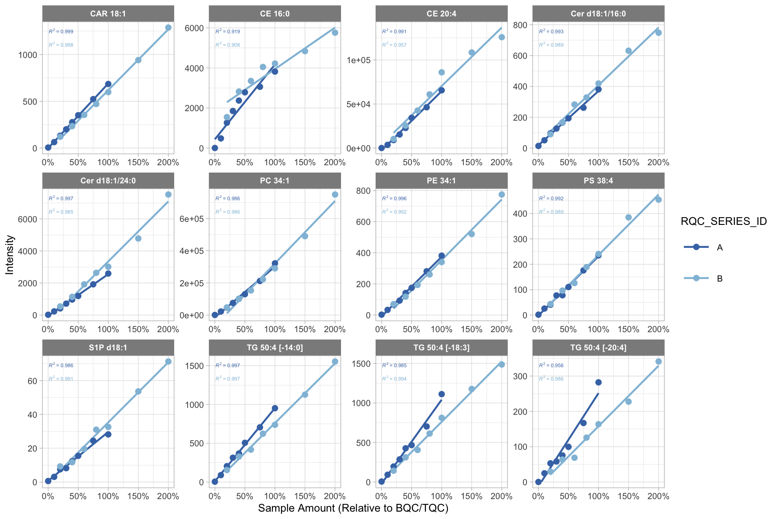
Analytical Linearity
Figure 3: Raw signal intensity as a function of sample amount analysed by the mass spectrometer. Responses should be linear. Passed, except some CE

Slide 11
EXPLORATORY DATA ANALYSIS

Slide 12
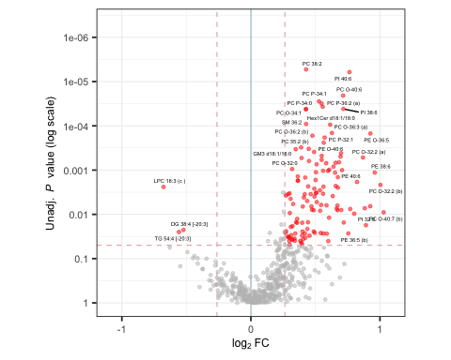
Statistical Comparison of Groups (M vs F)
Figure 4: Statistical comparison between the experimental groups M and F using Welch’s t-test. Lipid species with significant differences between F and M are highlighted in red (P < 0.05 and |FC| > 1.2).

Slide 13
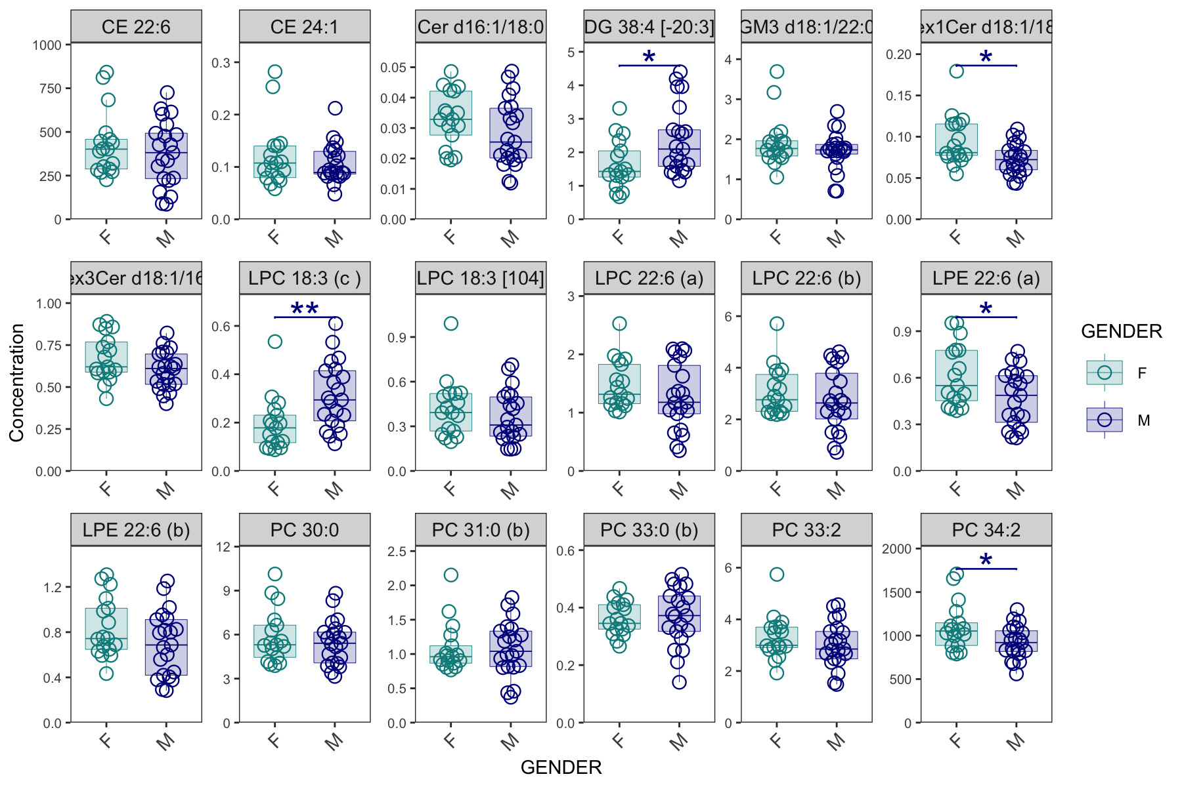
Significanlty different lipid species
Figure 5 Lipid species with statistically significant (P > 0.5, |FC| > 1.3) differences between M and F.

Slide 14
Effects
μmol/L
Run order

Slide 15
Effects
μmol/L
Run order

Slide 16
What do we learn and do !?
Aim to do a SST BEFORE the run (how can we help?)
Check your run DURING the run (dare to stop it…)
Check your run AFTER the run (dare to re-run it…)
Are our instrument methods OK?
Share issues !!
Learn from data
“Must read”

